Slide 1
Fukushima Nuclear Disaster
Moneer Aljawad, Abdulrahman Alshodokhi, Jericho Alves,
Daniel Chief, Benjamin Kurtz, Travis Moore
September 16, 2013

Slide 2
Overview
Introduction Information About The Disaster
Background Information About The Fukushima Daiichi Power Plant
TEPCO’s Safety and Ethical Decisions
Why Is It Still In The News?
United States Prevention
Future Prevention
Conclusion

Slide 3
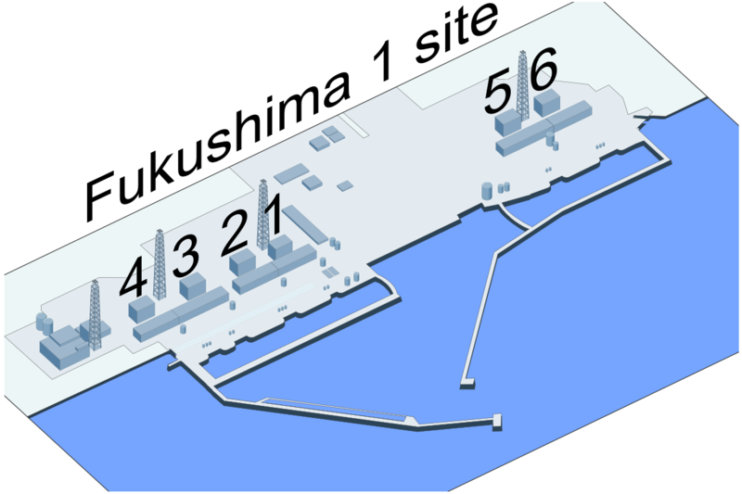
Fukushima Daiichi Power Plant Disaster
Took Place On: March 11th 2013
Where: Fukushima Daiichi Power Plant in Okuma, Japan
Cause: The Tohoku earthquake and resulting tsunami
What Happened:
  Damage only suffered from Tsunami
  Lower levels of plant were flooded
  Reactors 1, 2, and 3 melted down
  Hydrogen explosions
  20km evacuations
(Wikipedia)

Slide 4
Background about Fukushima
The Fukushima Power Plant is run by the Tokyo Electric Power Company (TEPCO).
The boiling water nuclear power plant began operation in 1971.
Plant is 3.5 million square meters and consists of 6 reactors.
Uranium dioxide sintered pellets as fuel source.
Max Capacity: 4,696 MW
Annual Capacity: 29891 GW-h
Power Plant generates 27% of TEPCO’s nuclear power.

Slide 5
Background about Fukushima
During initial construction,1966, the Isolation Condensing System (ICS) was changed from the original plans and merged with another system.
In 1991 one of the backup power supply generators was flooded due to a cooling system leak.

Slide 6
Ethical Decisions By TEPCO
TEPCO was a party in multiple scandals about inspections and safety regulations being falsified.
In 2008 the International Atomic Energy Agency warned that the plant’s safety guidelines were outdated, TEPCO made no changes.
TEPCO’s own safety inquiry lead to a discovery that the plant could not withstand a 10m tsunami wave, again no action taken.
Warnings from US Nuclear Regulatory Commission and Industrial Safety Agency were neglected for back-up power.

Slide 7
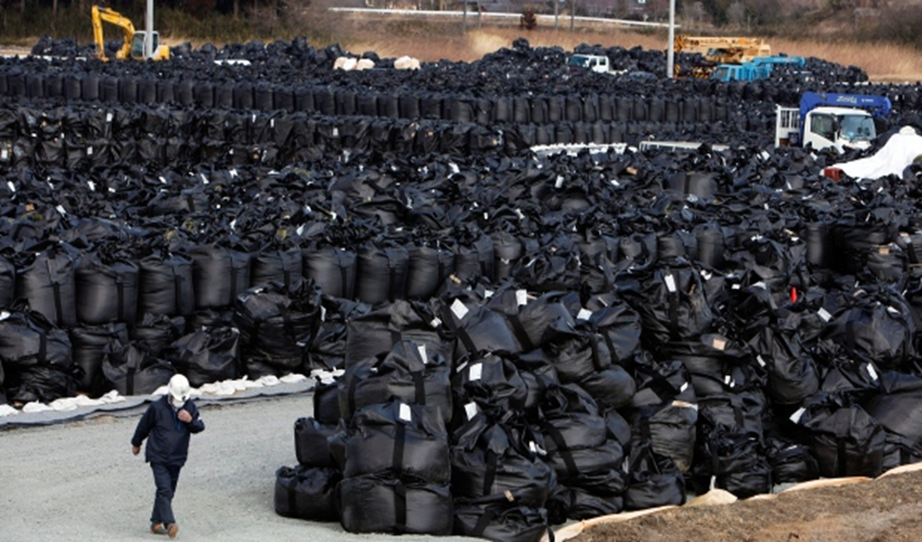
Why is it still in the news?
Improper Storage
Tropical Storm Man-yi
Health Risk
2020 Olympics
(Wikipedia)

Slide 8
What if it happens in the U.S.?
Lessons from Fukushima
U.S. Nuclear Regulatory Commission

Slide 9
Future Preventions
Nuclear reactors must be away from towns and villages.
The nuclear area must be geographically stable.
The need for appropriate cooling systems to avoid potential meltdowns.
The reactor must have at least three days backup batteries.
The need for further rules and regulations regarding the safety systems in place in all nuclear power plants.

Slide 10
Conclusion
Factors leading to the disaster:
Incorrect execution of construction plans.
The plant was under-designed to withstand tidal levels.
TEPCO ethically ignored numerous safety regulations.
Only the tsunami damaged the plant.
Overheating lead to nuclear meltdown, hydrogen explosions, and current radioactive waste leakage.
Future Solutions;
Regulations must be strictly applied to prevent incidents in the future that are based upon location, safety precautions, and failure plans.

Slide 11
References:
“Fukushima Accident 2011.” World-Nuclear Association. N.P., 9 Sept. 2013 Web. 16 Sept. 2013
"Fukushima Accident Analysis Report." Tokyo Electric Power Company. N.p., 20 June 2012. Web.
“Fukushima Daiichi Nuclear Disaster.” Wikipedia. N.P., Web 16 Sept. 2013
Kitamura, Makiko. "Full original Development Fukushima accident, m ni alarm NRC is it 20 years ago." Bloomberg JP. N.p., 16 Mar. 2011. Web. 16 Sept. 2013.
"Stabilisation at Fukushima Daiichi." Stabilisation at Fukushima Daiichi. World Nuclear News, 20 Mar. 2011. Web. 16 Sept. 2013.

Slide 12
Any Questions or Comments?

